Slide 1
Media Habits of Streamers
Brian Allers
SVP, Business Development

Slide 2
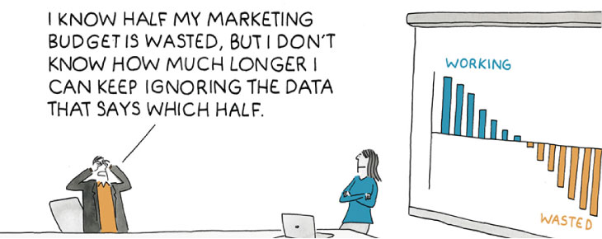
…

Slide 4
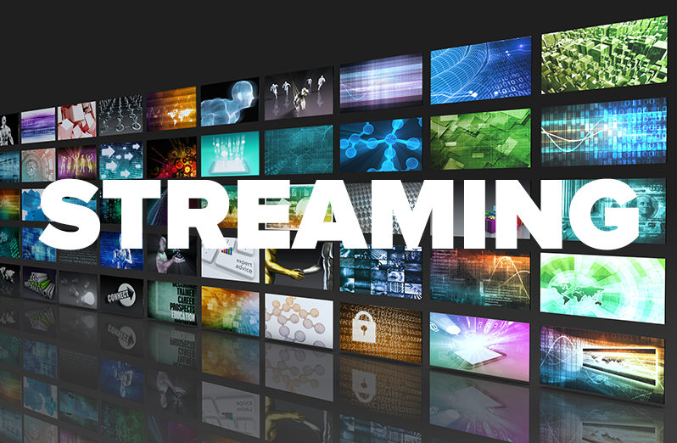
Value of Streaming
Precise targeting
“Better, smarter form of cable”
Real-time engagement metrics
Connect with viewers in a more personal way
Eliminates time periods

Slide 5
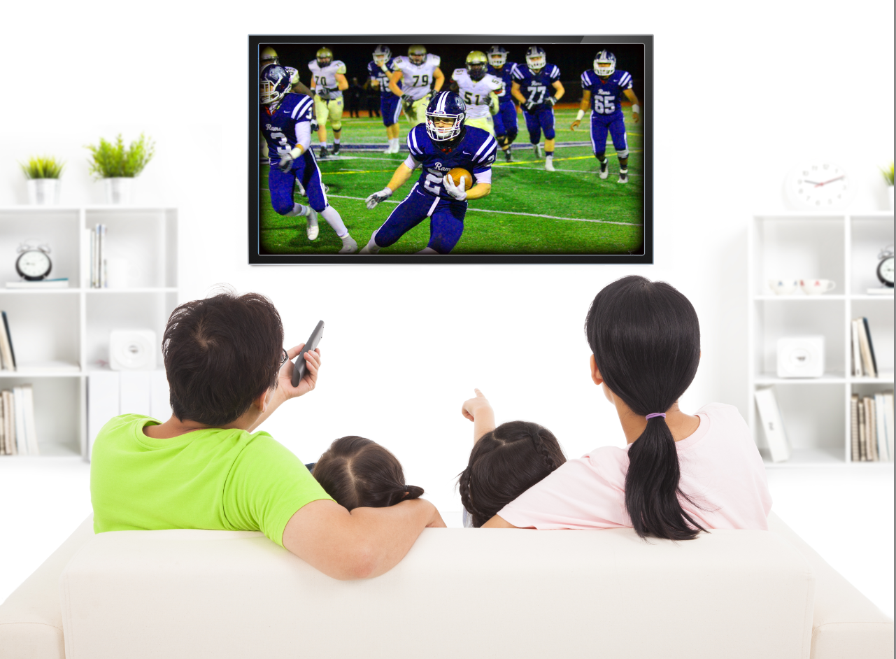
Value of Broadcast
Wider audience reach
Established viewership
Brand recognition
Credibility and Trust

Slide 6
Mass Reach….
Streaming
Broadcast
With One-to-One Precision

Slide 7
Time Spent

Slide 8
People Spend the Most Time with Television
Source: GfK TVB Media Comparisons Study 2023. M-S 4A-2A. Persons 18+. Online/internet platforms such as email, social media, internet radio and websites, are totaled for any online device-PC, Smartphone and Tablets. Broadcast TV News Websites/Apps includes local TV station & network websites/apps for news/weather/sports.

Slide 9
Most Time Spent with TV Programs is on Traditional TV; People watch more Streaming with Ads than without Ads
Source: GfK TVB Media Comparisons Study 2023. M-S 4A-2A. Persons 18+.

Slide 10
Adults 18+ Ad-Supported Streamers

Slide 11
Adults 18+ Ad-Supported Streamers
This analysis focuses exclusively on those adults 18+ that use a streaming service on a TV set or mobile device (smartphone, computer, or tablet) to stream programs/movies with advertising, as well as other video than TV programs or movies, like YouTube or online-only videos.
We are breaking these Ad-Supported Streamers out from the overall Adults 18+ numbers in order to see how their media consumption is different than overall Adults 18+. Do they watch linear TV, where do they get their news information from, and what news media do they trust the most?

Slide 12
Do Ad-Supported Streamers Watch Linear TV? Yes, in Fact Linear TV Has the Highest One Day Reach of These Streamers
Source: GfK TVB Media Comparisons Study 2023. M-S 4A-2A. Persons 18+ ad-supported streamers on TV or mobile device. Online/internet platforms are totaled for any online device-PC, Smartphone and Tablets.

Slide 13
Ad-Supported Streamers Spend Much More Time with Television Than Streaming
Source: GfK TVB Media Comparisons Study 2023. M-S 4A-2A. Persons 18+ ad-supported streamers on TV or mobile device. Online/internet platforms are totaled for any online device-PC, Smartphone and Tablets.

Slide 14
90% of Ad-Supported Streamers Also Watch Linear TV; Only 10% Exclusively Stream
Source: GfK TVB Media Comparisons Study 2023. M-S 4A-2A. Persons 18+ ad-supported streamers on TV or mobile device.

Slide 15
Ad-Supported Streamers Primary Source For News: Broadcast Television
Which one of the following sources, if any,
would you say is your primary source for news?
Source: GfK TVB Media Comparisons Study 2023. Persons 18+ ad-supported streamers on TV or mobile device. Includes only those who chose a media. QO5 - Which one of the following sources, if any, would you say is your primary source for news? Broadcast TV News & Broadcast TV News Websites/Apps include local TV station & broadcast network telecasts and websites/apps for news/weather/sports.

Slide 16
Ad-Supported Streamers Primary Source For Local Traffic, Weather & Sports: Local Broadcast Television News
What source do you turn to first for information about local weather, traffic, or sports?
Source: GfK TVB Media Comparisons Study 2023. Persons 18+ ad-supported streamers on TV or mobile device. Includes only those who chose a media. QO6 - What source do you turn to first for information about local weather, traffic, or sports? Cable TV News Websites/Apps, Radio Websites/Apps, National and Local Newspapers, Streaming Radio, and Podcasts were under 3% each.

Slide 17
Local Broadcast Television News: #1 For Trust For Ad-Supported Streamers
I trust the News that I see/hear on this media source:
Percent Agree
Source: GfK TVB Media Comparisons Study 2023. Persons 18+ ad-supported streamers on TV or mobile device. Agree Strongly or Agree Somewhat. QO9 - For each source, please indicate the extent to which you agree or disagree with the following statement: I trust the News that I see/hear on this media source.

Slide 18
Out of 5 choices, the top 4 were Broadcast Networks
If you could choose only five networks, which five would you choose?
Network “A”
Network “B”
Network “C”
Network “D”
Network “E”
BROADCAST NETWORK
CABLE NETWORK
Source: GfK TVB Media Comparisons Study. QTV4 – “Now think about all the television networks you watch, either regularly or occasionally. If you could choose only five networks, which five would you choose?” Respondents were given 50 choices of Broadcast and Cable Networks with an option to write in a network.

Slide 19
Streaming budgets CANNOT come from Broadcast – time to peel off cable

Slide 20
Average Number of Streaming Services
4.0
5.0
6.3
6.9
6.9
8.8
9.9
Source: TiVo​

Slide 21
How do Advertisers reach viewers in Detroit, MI?
2022
2023
Comcast Spotlight 50.1%
Comcast Spotlight 44.2%
Wired Cable
AT&T U-verse
Bright House
Comcast Cable
Spectrum
WOW
D&P Communications
Wired Cable
AT&T U-verse
Bright House
Comcast Cable
Spectrum
WOW
D&P Communications
Source: The Nielsen Company – Nov’22 - Nov'23 Detroit, MI DMA Quarterly UEs & DMA Cable Plus. (OTA=Over-the-Air or Broadcast Only homes).

Slide 22
Deep Dive on BBO Homes in Detroit
37.5% of Detroit homes are BBO Homes
P65+
8.7%
P55-64
8.5%
Of those homes…
Persons aged 34 and under account for 53.9% of all BBO homes!
P35-54
28.9%
UNDER 34
53.9%
Sources: Nielsen Local TV View, Data Stream Live+1, 10/26/23 – 11/22/23 Detroit DMA

Slide 23
Broadcast reaches ALL ad supported viewing in Detroit, MI
Cable is Splintered
Broadcast Reaches ALL TV Homes
Broadcast
100%
REMEMBER: Local cable commercials aren’t seen in every satellite home

Slide 24
Influence

Slide 26
Broadcast and Streaming are Full Funnel!
Reaching Consumers Early
Awareness
Interest
Preparing for
Purchase
Decision
Visit Store/Website for Info
Consider Purchasing
Making a
Purchase
Purchase

Slide 27
Television is The Top Advertising Medium That Influences Ad-Supported Streamers Purchase Decisions
Advertising medium which you feel most influences you to make a purchase decision
% Adults 18+ Ad-Supported Streamers
Source: GfK TVB Media Comparisons Study 2023. Persons 18+ ad-supported streamers on TV or mobile device. Includes only those who chose a media. QO1 - Please select the one type of advertising medium which, you feel, most influences you to make a purchase decision? Broadcast TV News Websites/Apps includes local TV station & network websites/apps for news/weather/sports.

Slide 28
Using Broadcast and Streaming together

Slide 29
Mass Reach….
Streaming
Broadcast
With One-to-One Precision

Slide 30
REACH
REINFORCE

Slide 31
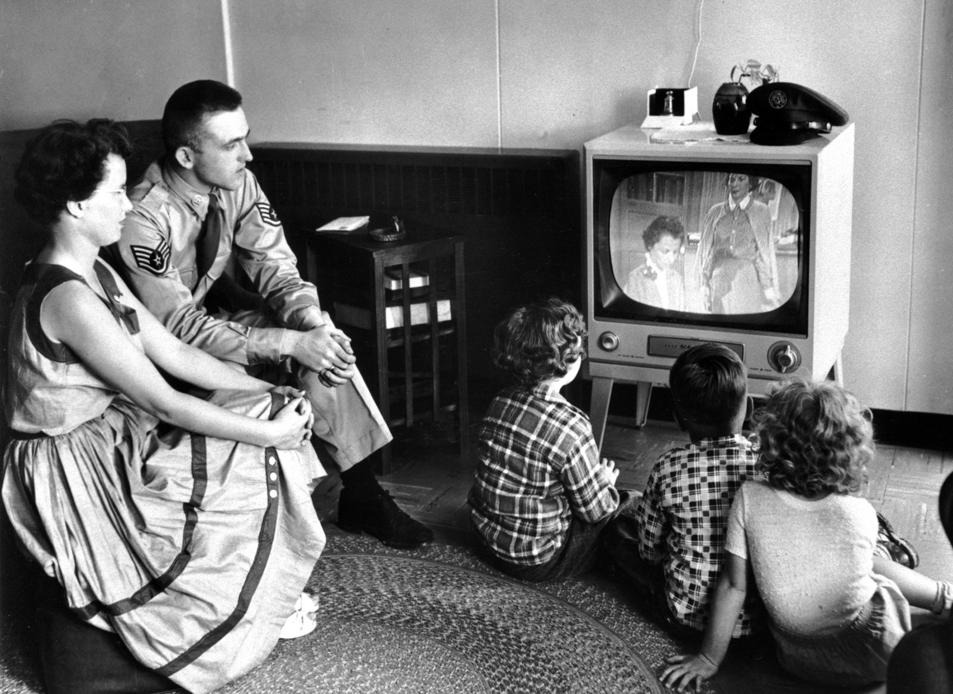

Slide 32
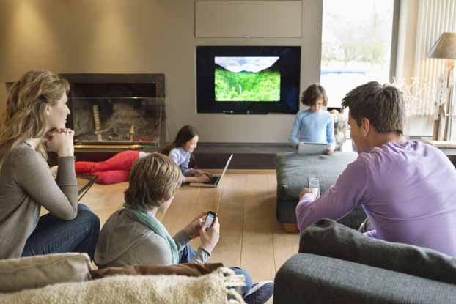

Slide 33
Television Ads Are Motivation For Ad-Supported Streamers To Do Further Research Online
Has an advertisement on television motivated you to go to the Internet to find out more information about that product or service?
Source: GfK TVB Media Comparisons Study 2023. Persons 18+. Persons 18+ ad-supported streamers on TV or mobile device. QO3 - Has an advertisement on television motivated you to go the Internet to find out more information about that product or service?

Slide 34
“When visiting a local television station’s website/apps, do you look at the video ads?”
Source: GfK TVB Media Comparisons Study 2023. Persons 18+. Persons 18+ ad-supported streamers on TV or mobile device. QO12 - And, when visiting a local television station’s website/apps, how often do you look at the video ads? Of those who go to a local station’s website or app. Includes only those who answered every time, most of the time, or sometimes.

Slide 35
“Have you read or watched local broadcast TV station content on a social media site?”
Source: GfK TVB Media Comparisons Study 2023. Persons 18+. Persons 18+ ad-supported streamers on TV or mobile device. Includes only those who answered all of the time, often, or sometimes. QO10 - Have you ever read or watched local broadcast TV station content on a social media site like Facebook, Twitter, Instagram, or TikTok?

Slide 36
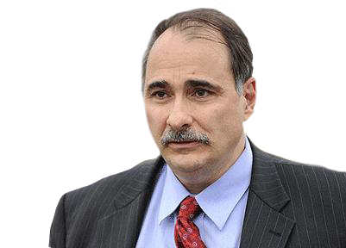
Broadcast is the
nuclear bomb.
David Axelrod — Former Obama Political Consultant

Slide 37
Key Findings For Ad-Supported Streamers
TV has higher reach and time spent for ad-supported streamers than streaming platforms.
90% of ad-supported streamers also watch linear TV.
Local Broadcast TV is turned to most for local news, even for ad-supported streamers.
Local TV news is the most trusted news source. Local TV news websites/apps are the most trusted digital source. Social media is the least trusted platform.
TV is the top advertising medium for purchase influence for ad-supported streamers.
Ad-supported streamers are more likely to be motivated by television ads to do further research online than the average adults 18+.
Ad-supported streamers are more likely to watch ads on a local TV station website and read or watched local broadcast TV station content on a social media site than the average adult 18+.

Slide 38
Thank you!
Brian Allers
brian@tvb.org

Slide 39
Research Methodology Overview
WHO:
Interviews were collected via opt-in panel.
The base sample included over 4,000 Adults 18+:
3,700+ English-speaking panelists 18+ years of age and
An augment of 300 Spanish speaking Hispanics 18+ years of age.
How:
Via a 21 minute online quantitative survey.
Care was taken to have an equal number of respondents reporting on each individual day so as not to overweight any individual day.
WHEN: Interviews took place November 3rd through December 1st, 2022.
Source: GfK TVB Media Comparisons Study 2023.

Slide 40
Two parts to the survey
Time spent with media and reach
Attitudinal and media preference questions
There were also questions about usage of key categories (Automotive, Home Remodelers, Legal, QSR, Shoppers, Urgent Care, Dentist/Eye Care, Voters, Online Sports Betting, Personal Insurance). This allowed for delineation of media usage and attitudes, by product categories
Source: GfK TVB Media Comparisons Study 2023.

Slide 41
The 2023 Media Comparisons Study Provided Delineation of Those Who Streamed with Ads
TV
Radio
Print
Digital
(Broadcast, Cable and Streaming with Ads)
(Newspaper and Magazine)
Digital media include:
Cable News site/app
Email
Local Radio Stations site/app
Broadcast TV News site/app
Digital Newspaper
Digital Magazine
Search
Streaming Audio
Social Media
Podcasts
Streaming Programs On Digital Media With Ads
Streaming Programs On Digital Media No Ads
Streaming Video Other Than TV Programs on Digital Media

